Slide 1
SQL PROJECT
BY KAVIRAJAN.S

Slide 2


Introducing PROJECT
This project involves analyzing cricket match data stored across four different databases: batting_summary, bowling_summary, match_summary, and players. Each database contains specific tables with detailed records of batting performances, bowling statistics, match outcomes, and player profiles.

Slide 3
LIST OF CONTENTS
08
MOST ECONOMICAL BOWLER
01
Scorers in a Match
09
CENTURIES AND HALF-CENTURIES
02
BEST ECONOMY RATES
03
10
MOST SIXES IN A MATCH
MOST DISMISSALS BY A BOWLER
04
MATCH WINNERS BY MARGI N
05
PLAYERS' ROLES DISTRIBUTION
06
MAIDEN OVERS BY BOWLERS
07
TOP PARTNERSHIPS
01
BATTING AND BOWLING PERFORMANCE ANALYSIS
TEAM PERFORMANCE EVALUATION
02

Slide 4
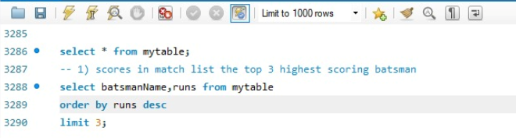
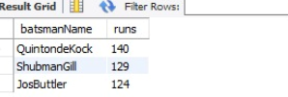
01
Scorers in a Match
List the top 3 highest-scoring batsmen for a given match along with their runs
definition:
Output:
This SQL query selects the top 3 batsmen by runs scored from the "batting_summary" database for a specific T20 match (ID: T20I566), retrieving their names and run totals, ordered from highest to lowest runs

Slide 5
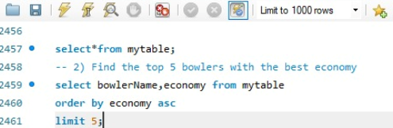
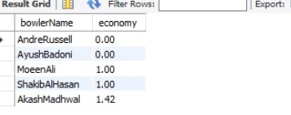
02
Best Economy Rates
Find the top 5 bowlers with the best economy rates in a given season.
Output:
definition:
This SQL query selects the top 5 most economical bowlers from the bowling_summary database, displaying their names and economy rates in order from lowest (best) to highest economy rate.

Slide 6
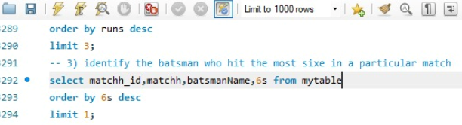

03
Most Sixes in a Match
Identify the batsman who hit the most sixes in a particular match.
Output:
definition:
This SQL query retrieves the highest individual score (6s) with the batsman's name and match ID from the batting_summary database for a specific match (T20I817), displaying only the top result.

Slide 7
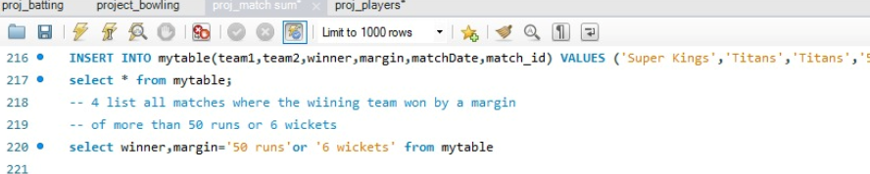
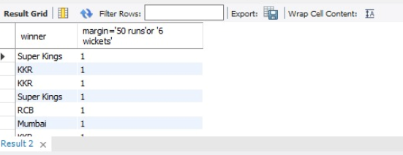
04
Match Winners by Margin
List all matches where the winning team won by a margin of more than 50 runs or 6 wickets.
Output:
definition:
This SQL query selects all columns from the match_summary database for matches where the winning margin was either greater than 50 runs or more than 6 wickets, effectively retrieving data on high-margin victories.

Slide 8
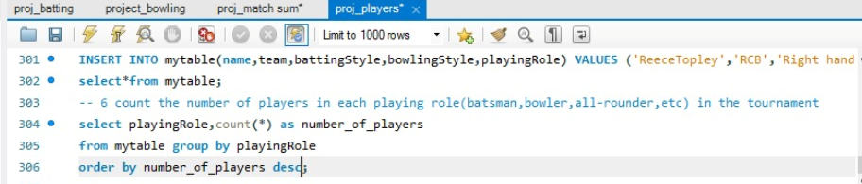
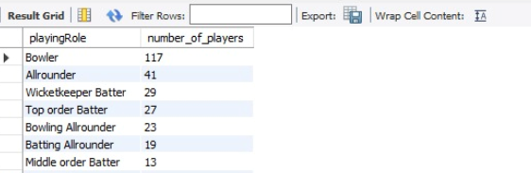
05
Players' Roles Distribution
Count the number of players in each playing role (batsman, bowler, all-rounder, etc.) in the tournament.
Output:
definition:
This SQL query retrieves the count of players for each unique playing role from a table named "mytable", grouping the results by the playing role.

Slide 9
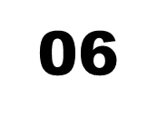
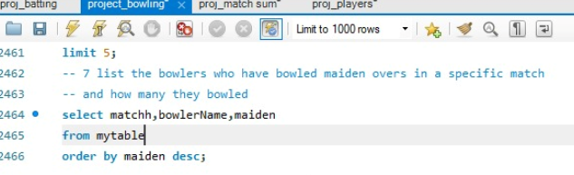
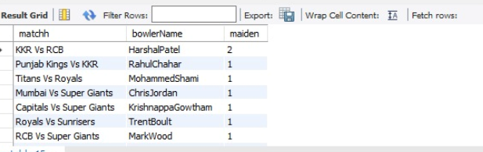
Maiden Overs by Bowlers
: List the bowlers who have bowled maiden overs in a specific match and how many they bowled.
Output:
definition:
This SQL query retrieves the bowler names and maiden counts from the "mytable" in the "bowling_summary" database for a specific match (ID "T285539"), showing only bowlers who have bowled at least one maiden over.

Slide 10
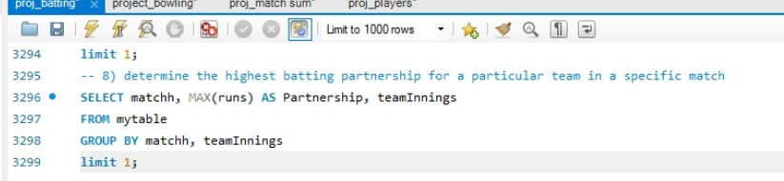
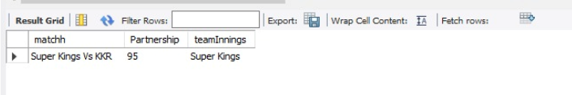
07
Top Partnerships
Determine the highest batting partnership for a particular team in a specific match
definition:
Output:
This SQL query finds the highest partnership score for the "Super Kings" team in match "T203817" by sum ming runs for each partnership and then selecting the maximum value from those sums

Slide 11
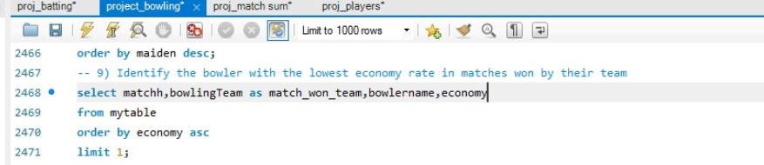

08
Most Economical Bowler
Identify the bowler with the lowest economy rate in matches won by their team.
Output:
definition:
This SQL query joins the bowling_summary and match_summary tables to retrieve the bowling team, bowler name, and economy rate for the top 2 most economical bowlers from the winning team of each match, ordered by economy rate in ascending order.

Slide 12
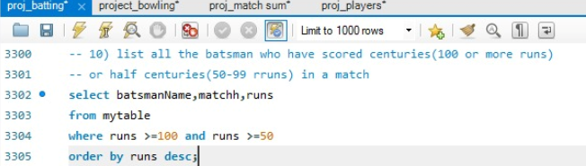
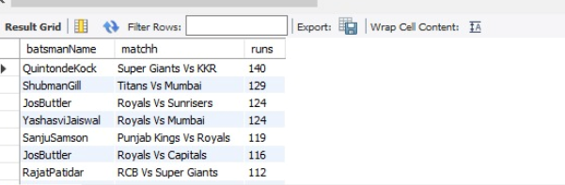
09
Centuries and Half-Centuries
List all the batsmen who have scored centuries (100 or more runs) or half-centuries (50-99 runs) in a match.
Output:
definition:
This SQL query retrieves the names of batsmen and their run scores from a table called "mytable", but only for those who scored 50 or more runs in a specific match identified by the ID "T203817".

Slide 13
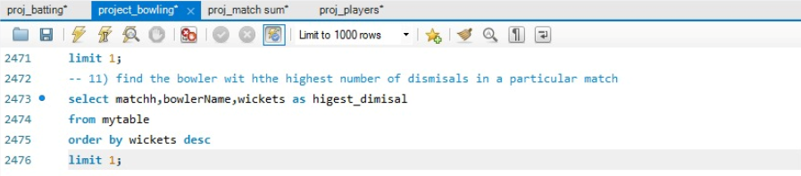

10
Most Dismissals by a Bowler
Find the bowler with the highest number of dismissals (wickets taken) in a particular match.
definition:
Output:
The SQL query in the image selects the bowlerName and wickets columns from the mytable table where the matchh_id is "T203817", orders the results by wickets in descending order, and limits the results to the top 2 rows.

Slide 14
notable
CONCEPTS
WHERE clause is used to filter records from a result set based on specific conditions. It allows you to retrieve only the data that meets your criteria, making your queries more precise and efficient.
subquery is a query nested within another query. It's used to retrieve data that is then used in the main query's WHERE, HAVING, or FROM clause. Subqueries allow for complex data manipulation and filtering.
ORDER BY clause is used to sort the result set of a SELECT statement in ascending or descending order based on one or more columns.
LIMIT clause restricts the number of rows returned by a SELECT query. It's often used for pagination, fetching specific numbers of records, or improving query performance on large datasets
JOIN combines rows from two or more tables based on a related column between them. It allows you to retrieve data from multiple tables simultaneously, creating a new result set with columns from both tables.

Slide 15
THANK YOU

